Slide 3
Promoting the NC Triad as a top destination to live, work and play
Showcasing job opportunities in the region
Highlighting lifestyle components, including the many amenities and benefits of living and working in the region

Slide 4
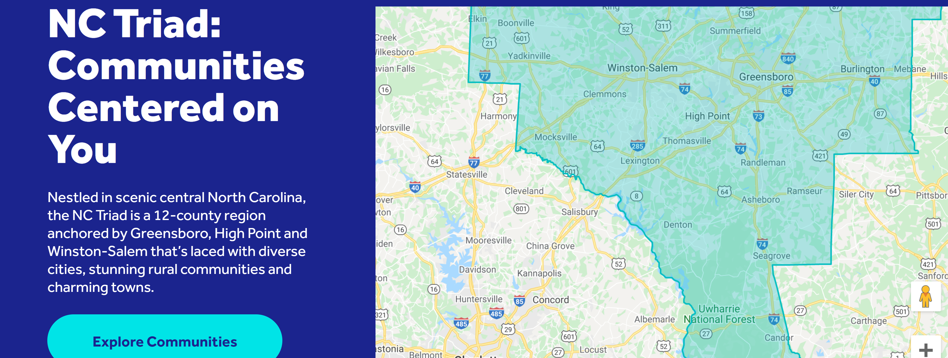
Exclusive Functionality
Cost of Living Calculator
Find A Job Portal
Commute Times
Triad Communities
Success Stories

Slide 5
How Can You Help?
Learn it.
Own it.
Share it.
Learn the messaging and exclusive functionality of the FindYourCenterNC.com tool.
Add information about FindYourCenterNC.com to your marketing materials, including your website and printed materials.
Share the importance of this tool with your networks and follow us on social media.

